Slide 1
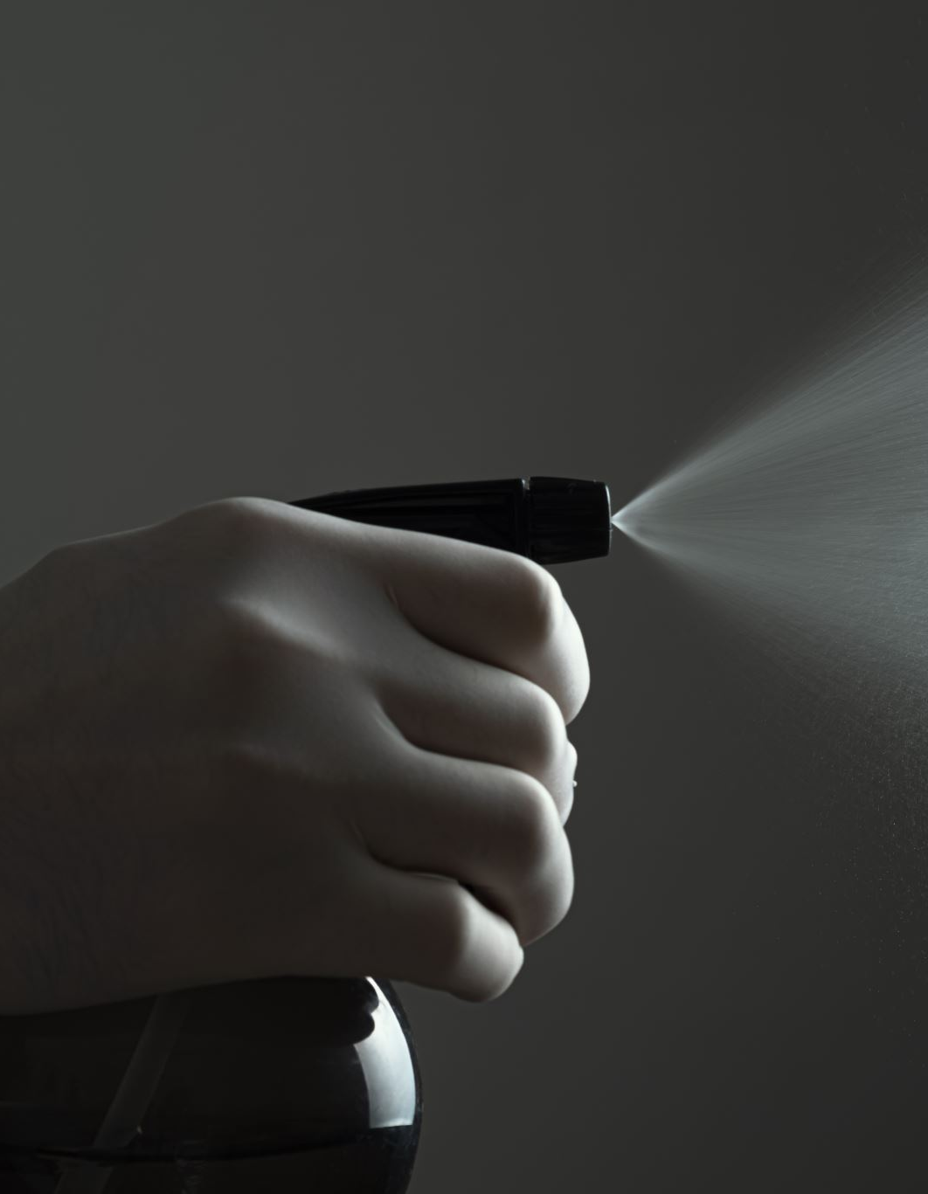
Year 9 Biology Lesson 4 Diffusion
Do Now Task: Think about the following question. Write down your thoughts. Compare with the person sitting next to you and be prepared to share with the class.
If someone sprays deodorant from the other side of the room, how does the smell reach your nose?

Slide 2
If someone sprays deodorant from the other side of the room, how does the smell reach your nose? Answer
Through a process called diffusion. The deodorant particles bump into air particles and are spread throughout the room. We smell the deodorant particles that reach our noses.

Slide 3
Objectives: To understand and be able to explain that
Diffusion is the movement of a substance from an area of high concentration to an area of lower concentration.
Diffusion occurs in liquids and gases when their particles collide randomly and spread out.
Diffusion is an important process for living things - it is how substances move in and out of cells.

Slide 4
Diffusion video
Watch this video to find out how the movement of particles in gases and liquids causes diffusion.
While you are watching, think about why diffusion is different in solids, liquids and gases.
https://www.bbc.co.uk/bitesize/articles/znqbcj6#zq6896f

Slide 5
What is diffusion?
Diffusion is the process by which particles of one substance spread out through the particles of another substance. Diffusion is how smells spread out through the air and how concentrated liquids spread out when placed in water.
Diffusion happens on its own when the particles spread out from an area of high concentration, where there are many of them, to areas of low concentration where there are fewer of them.

Slide 6
How does diffusion happen?
Diffusion occurs in gases like air and liquids like water because their particles can move around and collide with each other randomly.
For example, if you mix two drinks, the liquids diffuse into each other. Blackcurrant squash has a high concentration level. When the squash is mixed with water, it becomes less concentrated and is diluted.
Watch the video below to find out how making a cup of coffee involves diffusion.
https://www.bbc.co.uk/bitesize/articles/znqbcj6#zcwbvwx

Slide 7



Task: Use what you learned from the video and the diagrams below to describe diffusion of coffee.

Slide 8



1. Highly concentrated coffee molecules enter the cup of hot water.
2. Coffee molecules begin to spread out in between the water molecules.
3. Coffee molecules are now in a lower concentration than they started in.

Slide 9
What affects diffusion?
Two factors affect diffusion:
The type of substance - substances diffuse more quickly through gases than through liquids. This is because the particles in a gas are more spread out and move faster than the particles in a liquid.
Temperature - the hotter the gas or liquid, the faster diffusion happens. This is because the particles have more energy and move faster at higher temperatures.
Extension: Why doesn’t diffusion happen in solids?

Slide 10
Why doesn’t diffusion happen in solids?
Diffusion doesn’t happen in solids because the particles in a solid cannot move around, instead they vibrate about a fixed position.

Slide 11
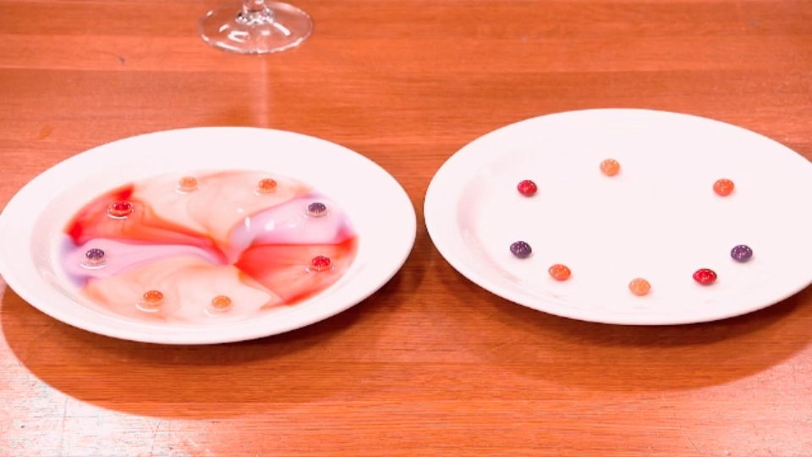
Diffusion plenary Answer the following questions in you books or on your whiteboards.
https://www.bbc.co.uk/bitesize/articles/znqbcj6#z2pjdp3

